Slide 1

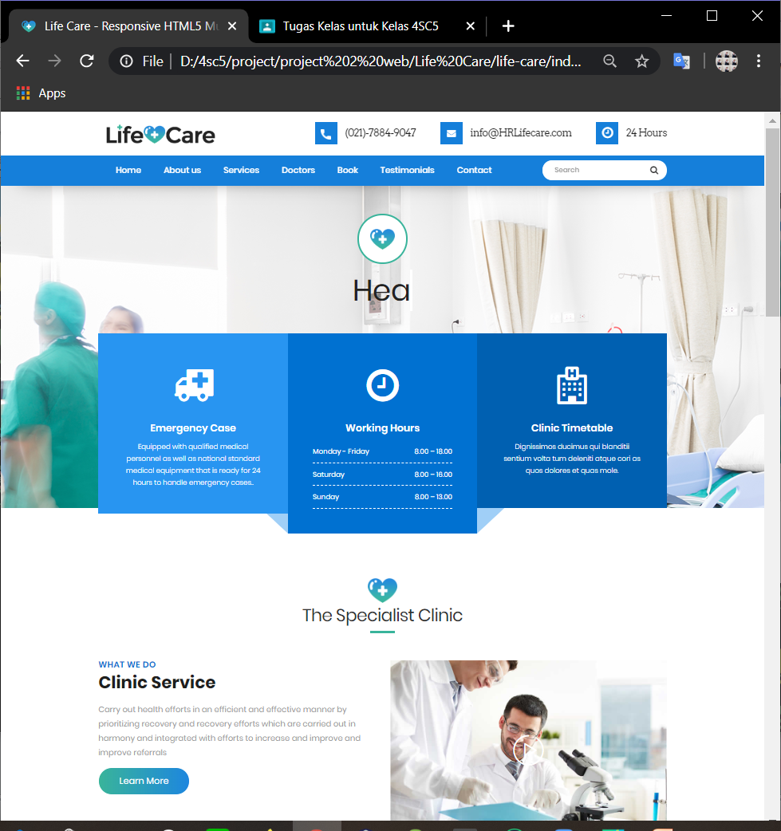
HR
Life Care

Slide 2


CEP CCIT-FTUI
Creator
1820010092
1820010181
Hudallil Muthaqin
Raudhiatul Ridwan

Slide 3
HR Life Care
HR Life Care is a website that shows all that is in our hospital. From good infrastructure, experienced doctors, hygienic operation rooms, and digital control centers. As well as our website has a feature that can make appointments with the desired doctor and hospital working hours.

Slide 4
Let’s go to our Website

Slide 5
Thanks!
Any questions?

